Slide 1

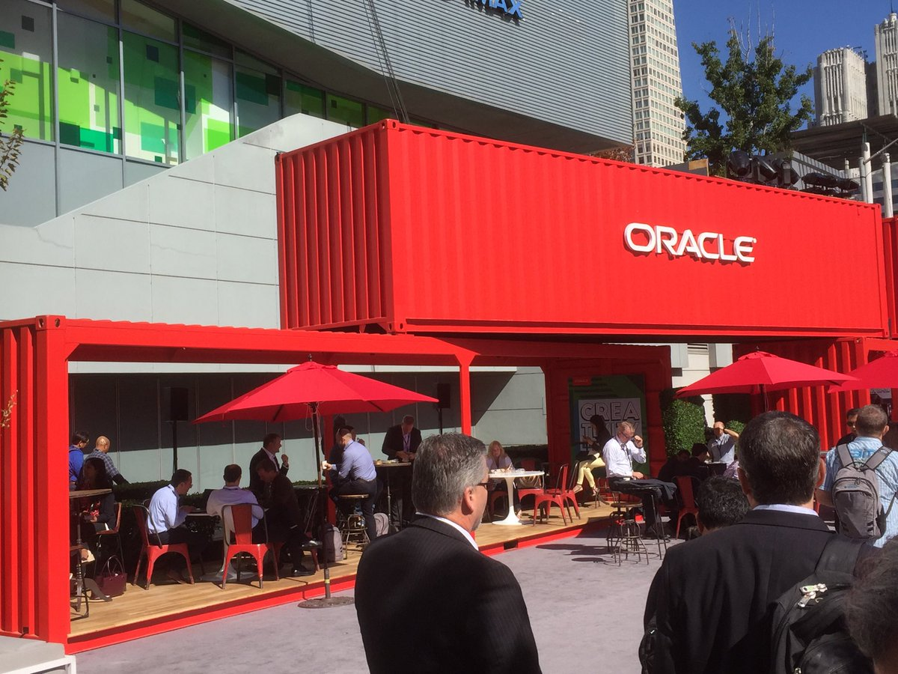

Introduction to the Oracle Cloud Microservices Platform open, manageable, polyglot and scalable
On what would be and still can be…
Lucas Jellema, CTO of AMIS
nlOUG Tech Experience 2018, Amersfoort, The Netherlands
Notes:
Fast data arrives in real time and potentially high volume. Rapid processing, filtering and aggregation is required to ensure timely reaction and actual information in user interfaces. Doing so is a challenge, make this happen in a scalable and reliable fashion is even more interesting. This session introduces Apache Kafka as the scalable event bus that takes care of the events as they flow in and Kafka Streams and KSQL for the streaming analytics. Both Java and Node applications are demonstrated that interact with Kafka and leverage Server Sent Events and WebSocket channels to update the Web UI in real time. User activity performed by the audience in the Web UI is processed by the Kafka powered back end and results in live updates on all clients.
Fast data arrives in real time and potentially high volume. Rapid processing, filtering and aggregation is required to ensure timely reaction and actual information in user interfaces. Doing so is a challenge, make this happen in a scalable and reliable fashion is even more interesting. This session introduces Apache Kafka as the scalable event bus that takes care of the events as they flow in and Kafka Streams for the streaming analytics. Both Java and Node applications are demonstrated that interact with Kafka and leverage Server Sent Events and WebSocket channels to update the Web UI in real time. User activity performed by the audience in the Web UI is processed by the Kafka powered back end and results in live updates on all clients. Introducing the challenge: fast data, scalable and decoupled event handling, streaming analytics Introduction of Kafka demo of Producing to and consuming from Kafka in Java and Nodejs clients Intro Kafka Stream API for streaming analytics Demo streaming analytics from java client Intro of web ui: HTML 5, WebSocket channel and SSE listener Demo of Push from server to Web UI - in general End to end flow: - IFTTT picks up Tweets and pushed them to an API that hands them to Kafka Topic. - The Java application Consumes these events, performs Streaming Analytics (grouped by hashtag and author and time window) and counts them; the aggregation results are produced to Kafka - The NodeJS application consumes these aggregation results and pushes them to Web UI - The WebUI displays the selected Tweets along with the aggregation results - in the Web UI, users can LIKE and RATE the tweets; each like or rating is sent to the server and produced to Kafka; these events are processed too through Stream Analytics and result in updated Like counts and Average Rating results; these are then pushed to all clients; this means that the audience can Tweet, see the tweet appear in the web ui on their own device, rate & like and see the ratings and like count update in real time

Slide 2
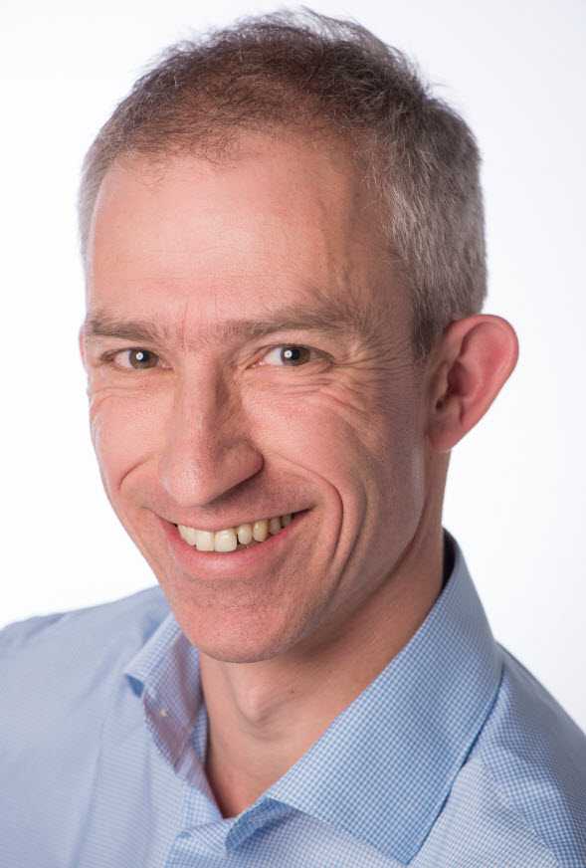
Lucas Jellema Architect / Developer 1994 started in IT at Oracle 2002 joined AMIS Currently CTO & Solution Architect

Slide 3
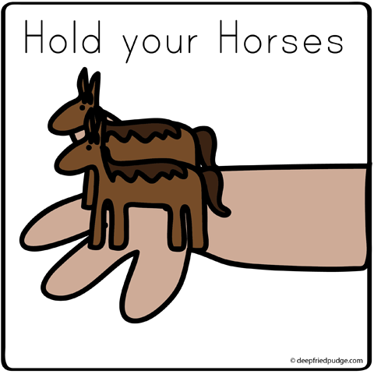
How do we implement microservices?
And how we make the containers horizontally scalable
How do we get from a Monolith to Microservices?

Slide 4
Why? What? How?
Notes:
Objectives
Requirements
Specifications

Slide 5
What is IT all about?
Production Runtime
Application

Slide 6
Objectives
Agility –
In functionality: quick, cheap, effortless and risk free
In non-functionality: scale, resilience, infrastructure & location
Real, Frequent Results that reliably run –

Slide 7
What is IT all about?
Production Runtime
Application
Platform

Slide 8
What is IT all about?
Production Runtime
Operations
Monitoring & Management
Application
Platform

Slide 9
Production Runtime is the Result of Preparation Runtime
Preparation Runtime
Production Runtime
Development
Operations
Monitoring & Management
Application
Application
Agile Design, Build, Test
Platform
Platform
CD

Slide 10
What?

Slide 11
One team has Agile responsibility through full lifecyle
Preparation Runtime
Production Runtime
Development
Operations
Monitoring & Management
Application
Application
Agile Design, Build, Test
Platform
Platform
CD

Slide 12
One team has Agile responsibility through full lifecyle
Preparation Runtime
Production Runtime
DevOps
Development
Operations
Monitoring & Management
Application
Application
Agile Design, Build, Test
Platform
Platform
CD
You build it, you run it, you fix it, you evolve

Slide 13
One team has Agile responsibility through full lifecyle
DevOps
Application
Application
Platform
Platform
You build it, you run it, you fix it, you evolve

Slide 14
DevOps team owns and runs one (or more) products
Application
Platform
Generic Infrastructure Platform for running DevOps Products
Floorspace, Power, Cooling, Storage, Compute
Monitoring, Management, Cache, Authentication, RDBMS, Event Hub

Slide 15
Multiple products from multiple teams run on a shared generic infrastructure
Application
Application
Application
Application
Application
Platform
Platform
Platform
Platform
Platform
Generic Infrastructure Platform for running DevOps Products
Floorspace, Power, Cooling, Storage, Compute
Monitoring, Management, Cache, Authentication, RDBMS, Event Hub

Slide 16
App plus platform under DevOps == Microservice
µ
µ
µ
µ
µ
Generic Infrastructure Platform for running DevOps Products

Slide 17
What?
Realistic approach (technology, people, process) => Something that works!
No dependency on individuals
Able to scale in rate of change
Small , well: comprehensible, manageable
stand alone /isolated/encapsulated (in terms of change, release/deploy, scale, - location, implementation)
Provide clear and meaningful functionality in a way that it can be consumed
Microservice does not completely fall over when other microservices break (or are redeployed)
Able to scale elastically & horizontally and relocate easily

Slide 18
How?

Slide 19
How microservices
One team owns the microservice and can do functional and technical evolution and deployment continuously and independently
The business ownership is clearly defined
Application
Platform

Slide 20
How microservices
Architect/Design, Implement and Rollout
Run & Operate

Slide 21
The Microservice
HTTP REST/JSON
API

Slide 22

How microservices: design & implement
Team ownership of application and associated platform
Automated CD – including regression test
Open (standards, protocols) on the outside, whatever you like inside
Deployable on enterprise standardized microservices platform
API & Event
Standard protocols for interaction
Horizontally scalable: multiple parallel instances
Stateless – horizontally scalable, fail over & restart
Private Bounded (Data) Context
Including derived data from other domains

Slide 23
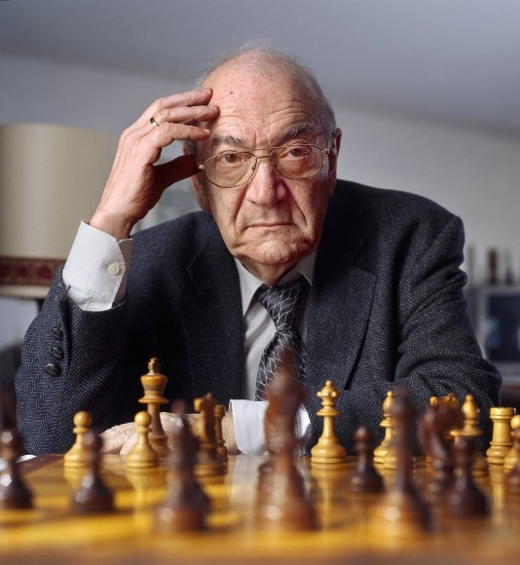
Notes:
Viktor Korchnoi – Stateless Chessplayer

Slide 24
Microservices State
Generic Platform for running microservices
LDAP
Big Data
Block Storage
Cache
RDBMS
NoSQL
Document Store
Event Hub
Notes:
All data stores are distributed
Or at least distributedly available
They can be local or on cloud (latency is important)
Data in generic data store is still owned by only one microservice – no one can touch it
Only in DWH and BigData do we deliberately take copies of data and disown them

Slide 25
Bounded context in microservices
A micoservice needs to be able to run independently
It needs to contain & own all data required to run
It cannot depend on other microservices
UI
API
Customer
API
Order
CustomerModified event

Slide 26

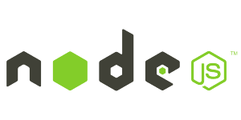






Demo – Maintaining Derived Data in Bounded Context
Customer Microservice
Order Microservice
Customer Modified Event
Application Container
Application Container
Event Hub
Customers
Topic
DBaaS

Slide 27
Microservices based Webshop
Web Shop Portal
µ Customers
µ Orders
µ Products
µ Loyalty
µ Finance
µ Logistics
µ Customers
µ Orders
µ Products
µ Loyalty
µ Finance
Notes:
dazzle the audience with a quick dump of all technologies (and cloud services) used for putting the webshop together - for the UI, the API implementation, the datastores and the event bus.

Slide 28




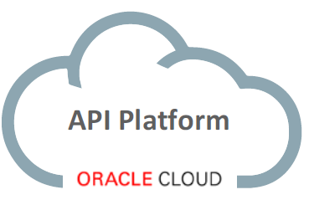
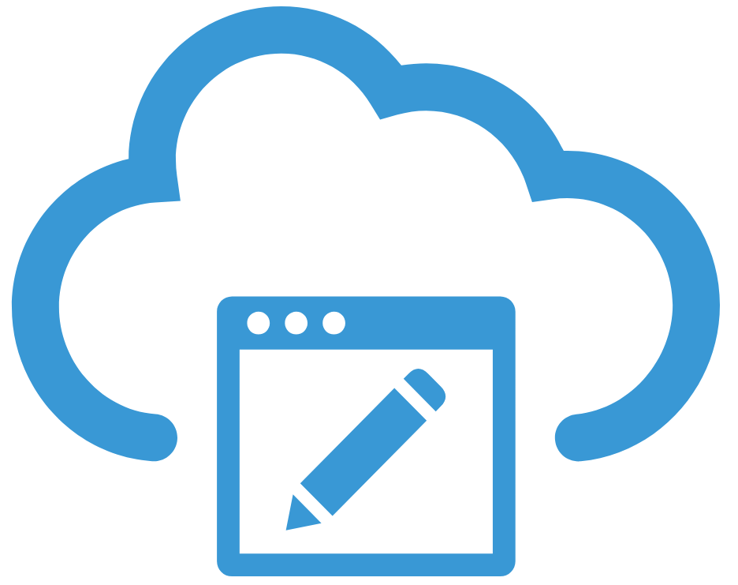


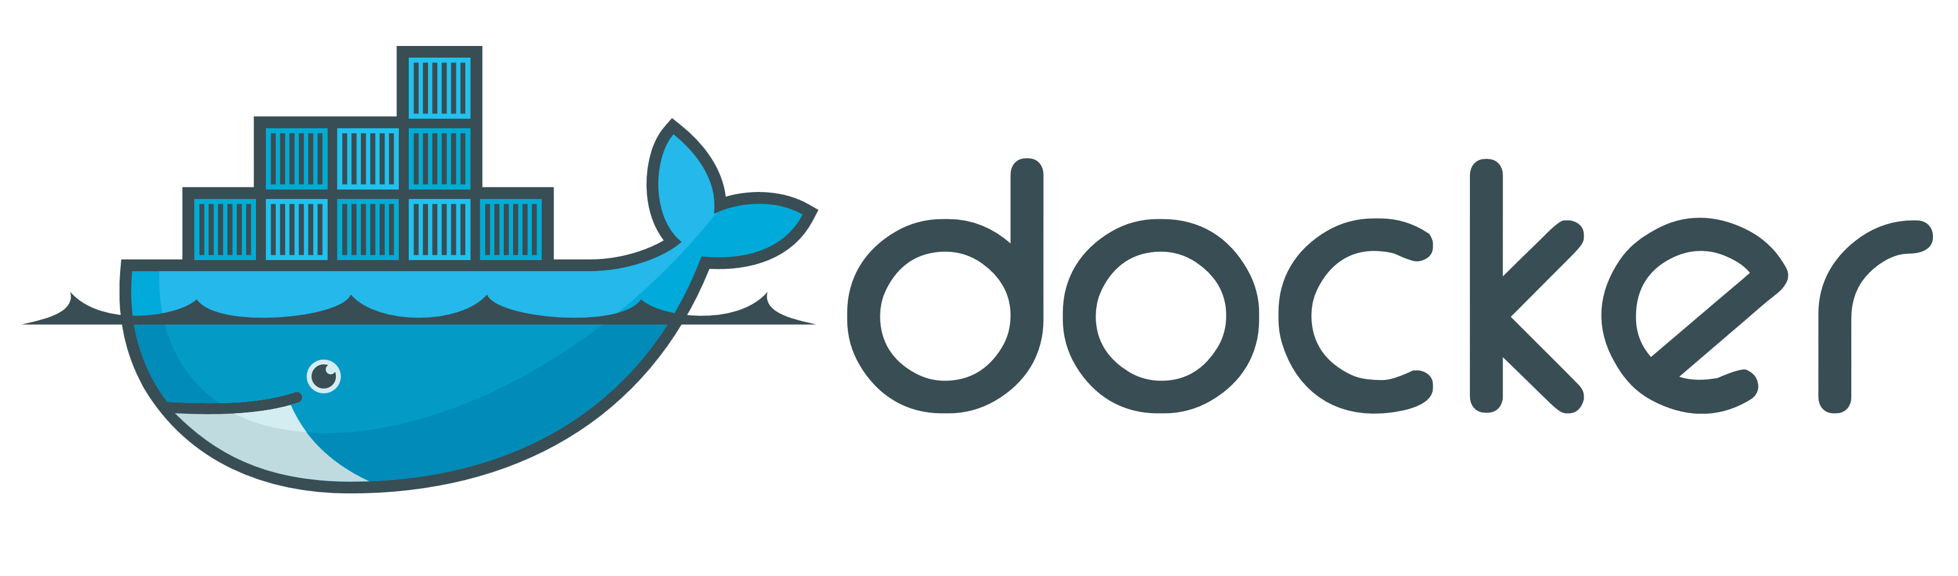
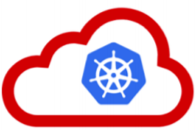






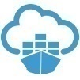



API Portal
Web Shop Portal
µ Customers
µ Orders
µ Products
µ Loyalty
µ Finance
API Platform
Backoffice UI
λ
Event Schema Registry
Event Hub
Notes:
dazzle the audience with a quick dump of all technologies (and cloud services) used for putting the webshop together - for the UI, the API implementation, the datastores and the event bus.

Slide 29

…. Event-(First) Driven
Event Monitor
Product Update
Product added to Shopping Cart
Shop
Products
Event Hub
Topic X
Topic Y
Topic Z
Topic Q
New Customer
Customer Profile Changed
Customer Sign In
Customers
Order Payment Received
Customer Frozen
Customer Loyalty Status Change
Order Create
Order Cancelled
Product Stock Update
Shipping News
Loyalty Program
Order
Logistics
Finance

Slide 30
How? Run & Operate

Slide 31
Run & Operate Microservices
µ
µ
µ
µ
µ
Rapid rollout
Including scale out & recover
Non breaking upgrade & rollback strategies (canary)
Agile infrastructure
Relocate, independent of infra specifics
Health management
Monitor and safeguard SLA requirements on response time, success and availability
Scale elastically
TCO management
DevOps: one team creates and runs
Generic Infrastructure Platform for running DevOps Products

Slide 32
The elephant in the room…
whale

Slide 33
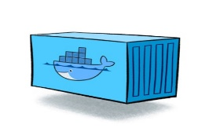
Containers
As vehicle for:
Encapsulate
Build
Share & Ship
Automated Tests
Deploy
Run
Scale
Relocate
Standardize

Slide 34
Looking for a runtime platform for
Compute Node
Notes:
Deploy and Run (Docker Containers)
Distributed infrastructure (scalable and available)
Hide infrastructure from DevOps teams
Auto-healing
Elastic Scale
Wire up the micros – connect dynamically (service discovery)
Load Balance
Provide Persistent storage
Rolling Upgrade
Configuration & Secret Management
Secure

Slide 35
Looking for a runtime platform for
Compute Node
Compute Node
Compute Node
Notes:
Deploy and Run (Docker Containers)
Distributed infrastructure (scalable and available)
Hide infrastructure from DevOps teams
Auto-healing
Elastic Scale
Wire up the micros – connect dynamically (service discovery)
Load Balance
Provide Persistent storage
Rolling Upgrade
Configuration & Secret Management
Secure

Slide 36
Looking for a runtime platform for
Compute Node
Compute Node
Compute Node
Notes:
Deploy and Run (Docker Containers)
Distributed infrastructure (scalable and available)
Hide infrastructure from DevOps teams
Auto-healing
Elastic Scale
Wire up the micros – connect dynamically (service discovery)
Load Balance
Provide Persistent storage
Rolling Upgrade
Configuration & Secret Management
Secure

Slide 37
Looking for a runtime platform for
Compute Node
Compute Node
Compute Node

Slide 38
Looking for a runtime platform for
Compute Node
Compute Node
Compute Node

Slide 39
Looking for a runtime platform for
Compute Node
Compute Node
Compute Node
Cloud Storage
SAN

Slide 40
Looking for a runtime platform for
Configuration Map
Configuration Map
Compute Node
Compute Node
Compute Node
Cloud Storage
SAN

Slide 41

Looking for a runtime platform for
Compute Node
Compute Node
Compute Node

Slide 42
Looking for a runtime platform for
Compute Node
Compute Node
Compute Node
Compute Node
Compute Node

Slide 43
Looking for a runtime platform for
Compute Node
Compute Node
Compute Node

Slide 44
Looking for a runtime platform for
v2
v2
v2
Compute Node
v2
v2
Compute Node
Compute Node

Slide 45
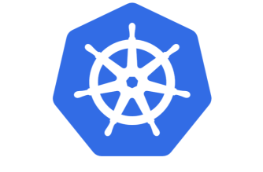

Slide 46
Introducing Kubernetes
Distributed Container Run Time Management platform
Based on Google’s Borg system (in use at Google for over a decade)
Initial announcement: 2014
Kubernetes v1.0 was released on July 21, 2015
A Kubernetes cluster typically spans multiple compute nodes
Either in the cloud, on premises, on a single machine (minikube) or hybrid
K8S manages Pods in which containers are running
K8S schedules Pods on one or more nodes
Docker can be the container runtime; other engines are supported as well, such as rkt and containerd
K8S handles network traffic to, between and from Pods
The kubectl command line interface is used for most management activities

Slide 47
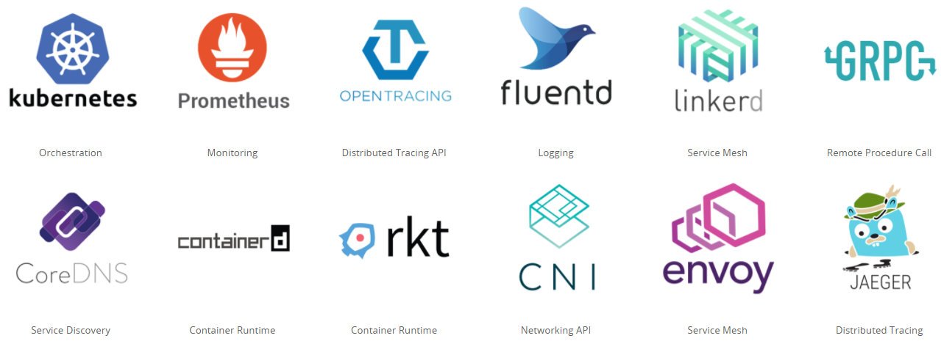
Cloud Native & Vendor Neutral
Cloud Native Computing Foundation - CNCF
Oracle is a platinum member since July 2017
Cloud Native: container packaged, dynamically managed, microservices oriented
Open technology for running container based workloads in a cross cloud vendor neutral way
Notes:
https://www.cncf.io/

Slide 48
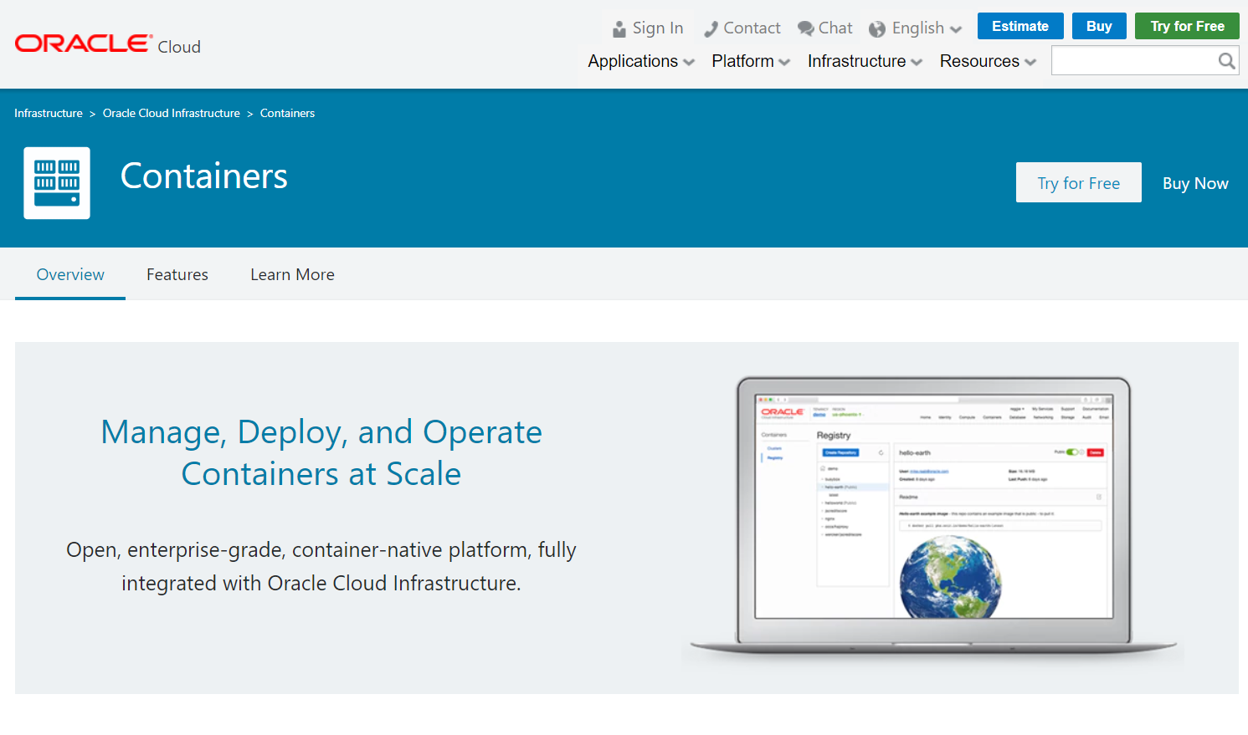

Slide 49
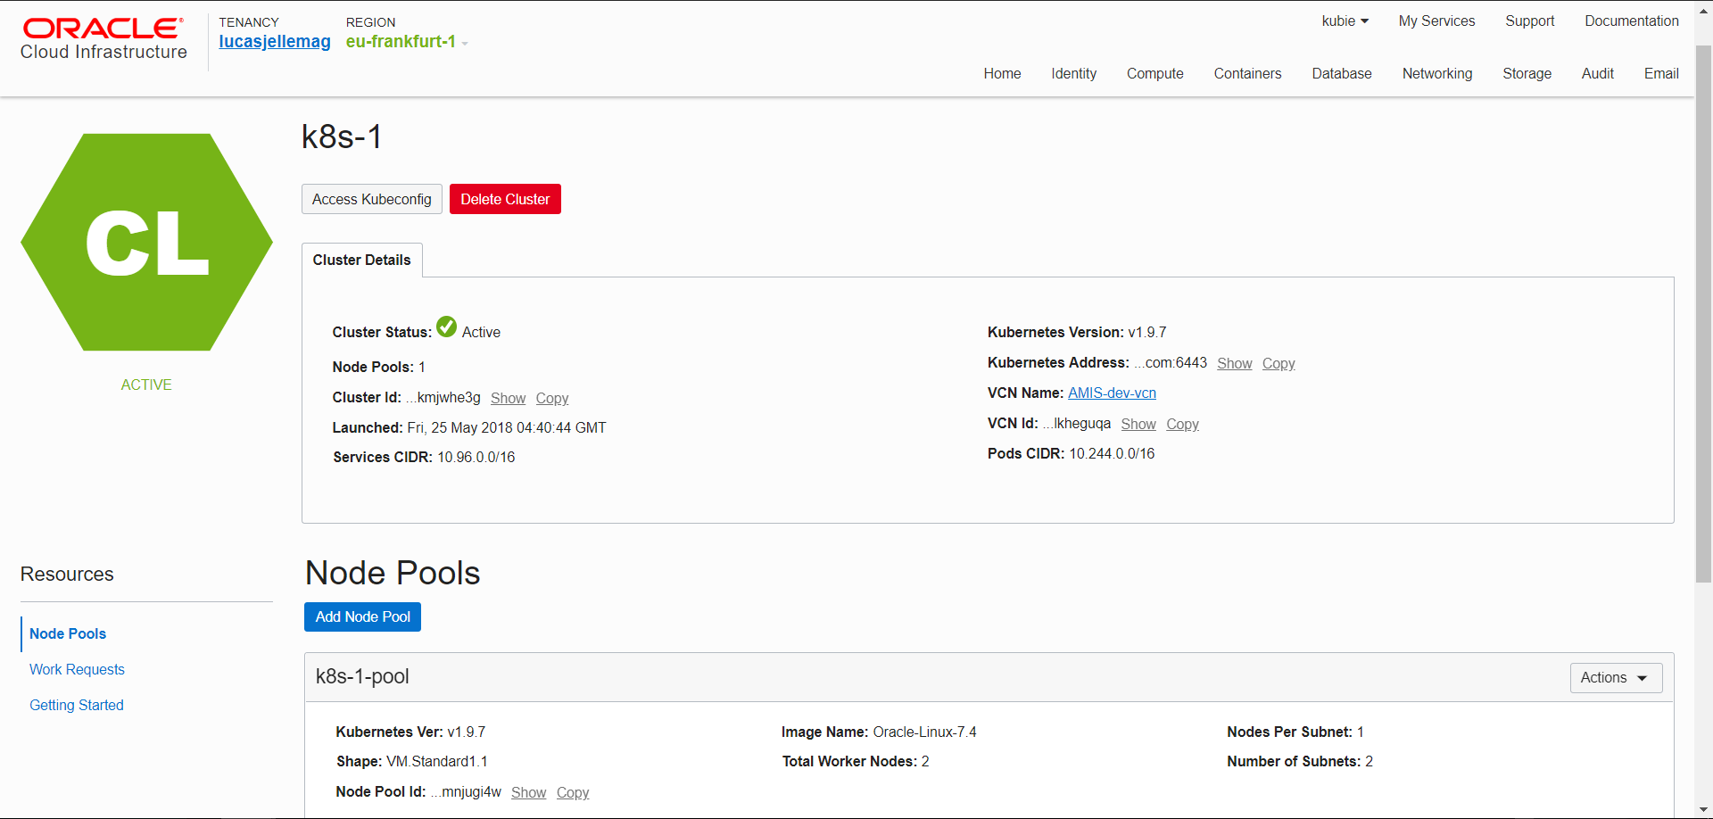

Slide 50
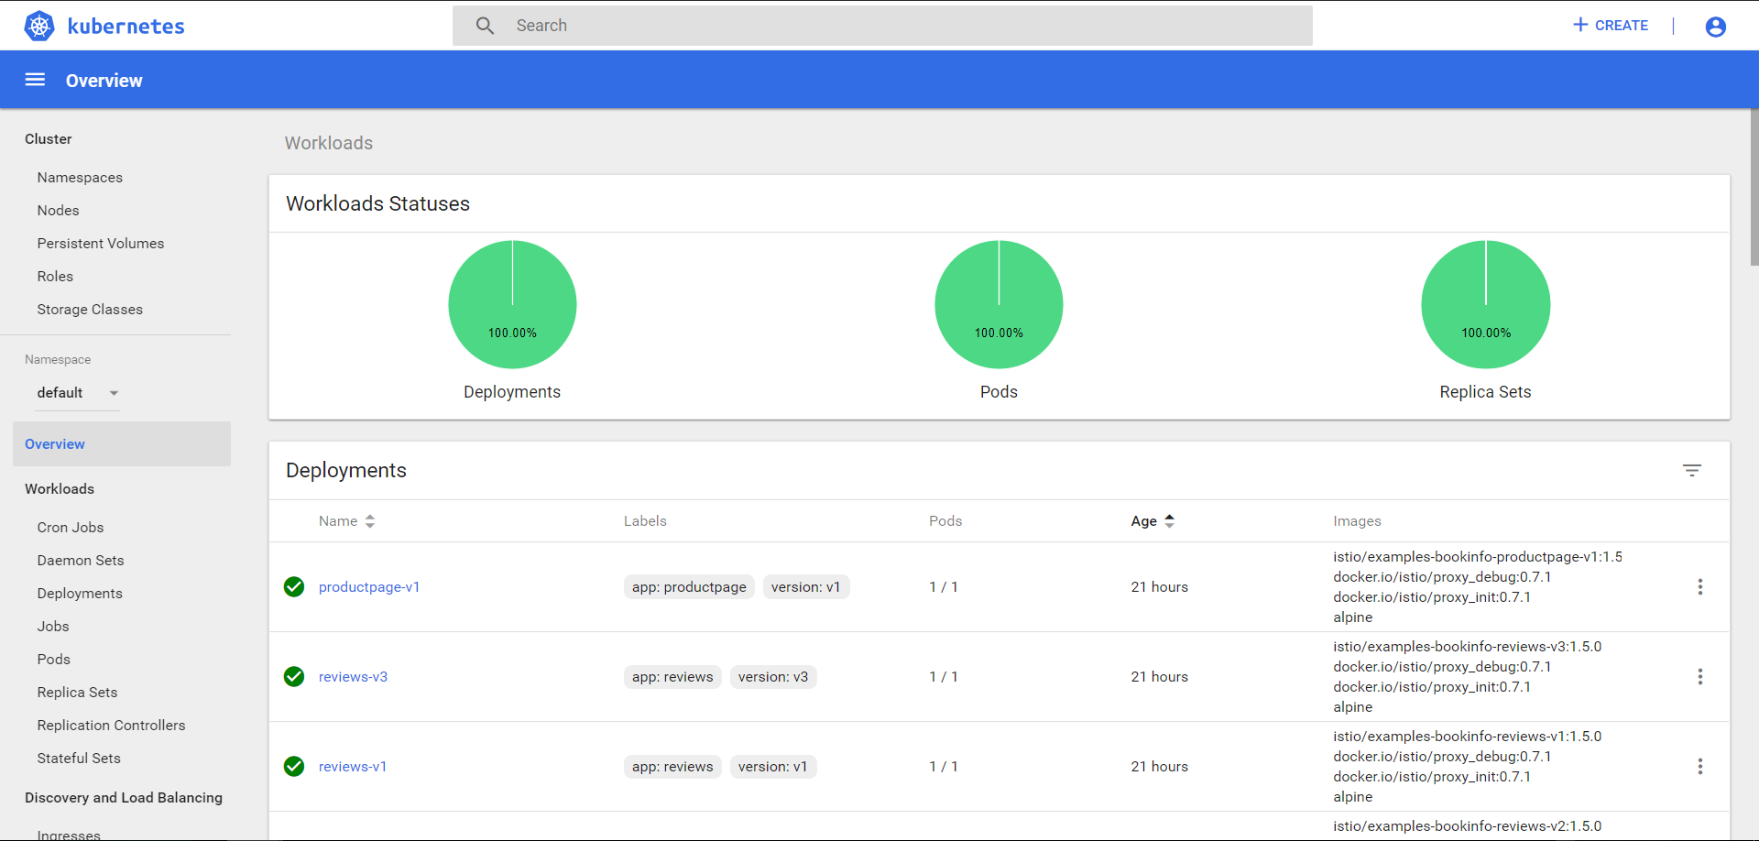

Slide 51
Kubernetes & OKE Demo

Slide 52
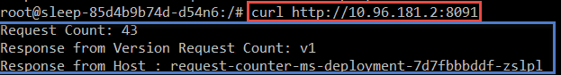
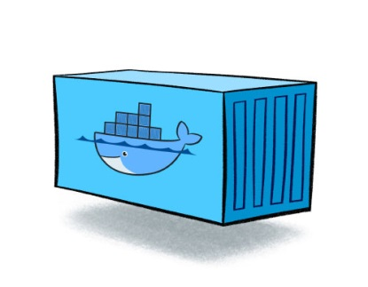
RequestCounter Microservice – V1
/
/health
/ready
/kill
http GET
RequestCounter
counter
Compute Node
Compute Node
Notes:
RequestCounter on K8S
Deployment with two replicas
Readiness Probe, Liveness probe
Kill-switch – special request that can disable liveness
Steps
Apply deployment with kubectl
Show in dashboard /cli two pods are started
Demo calls: load balanced, no shared state
Kill one – continue to make calls (no longer load balanced)
A second pod is started (because of liveness was broken)
Scale deployment to three – show that three pods are running
Upgrade to v2 – using Redis for shared state
Now kill all three (three rapid kill calls); new instances – proceed from same state

Slide 53
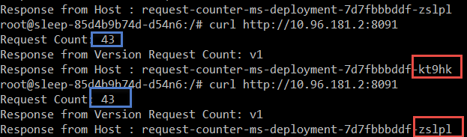
RequestCounter Microservice – V1
/
/health
/ready
/kill
http GET
RequestCounter
counter
counter
Compute Node
Compute Node

Slide 54
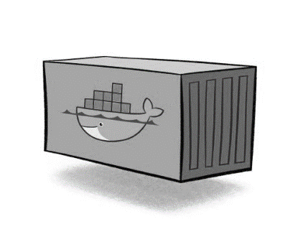
RequestCounter Microservice – V1
/
/health
/ready
/kill
http GET
RequestCounter
counter
counter
counter
counter=0
Compute Node
Compute Node

Slide 55
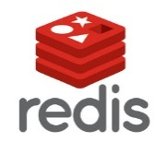
RequestCounter Microservice – V2
/
/health
/ready
/kill
http GET
RequestCounter v2
counter
Compute Node
Cache
Compute Node

Slide 56
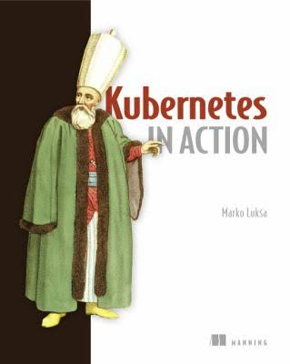

Slide 57
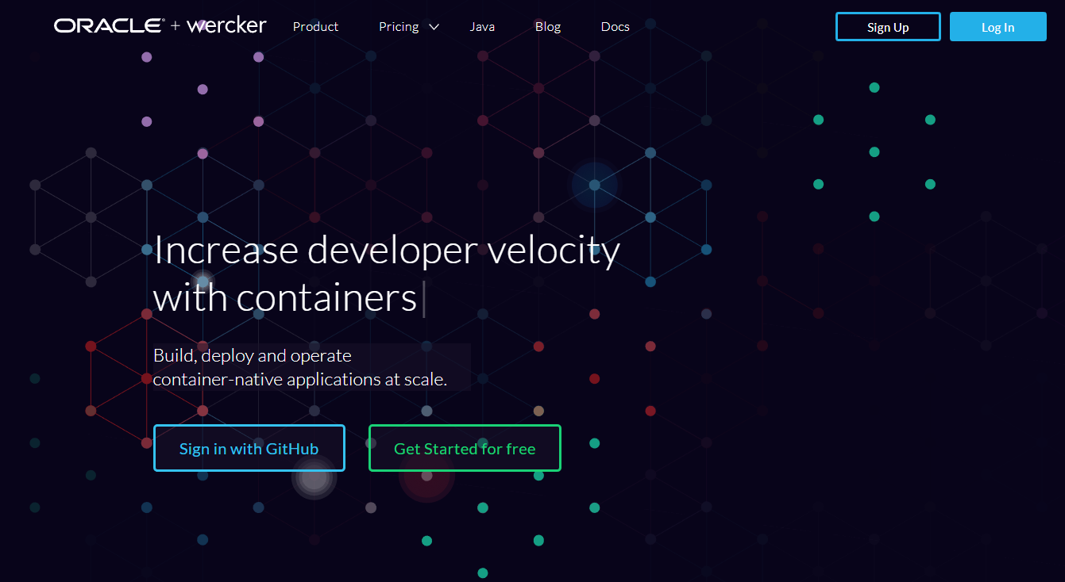
Automated Container [Build | Stock | Deliver] Pipelines
Oracle Wercker

Slide 58
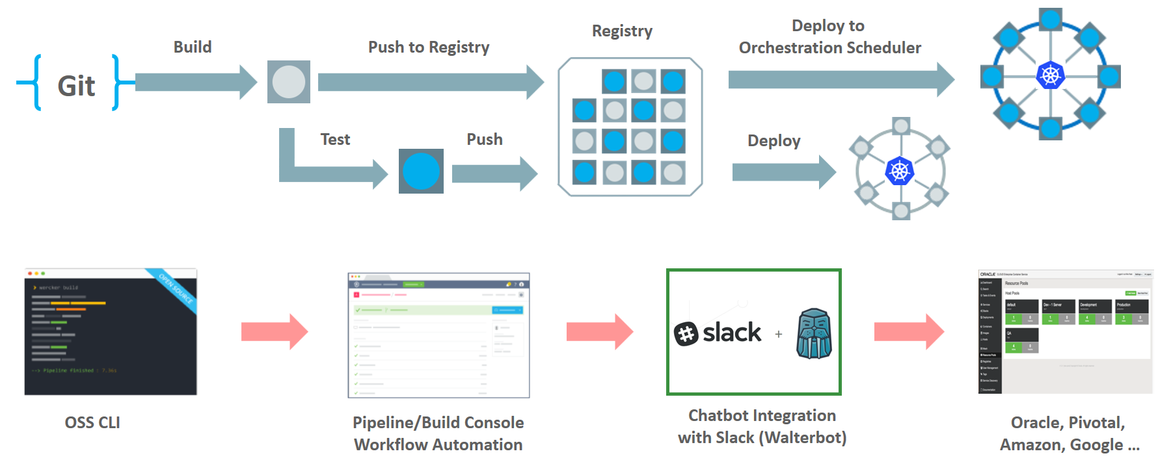
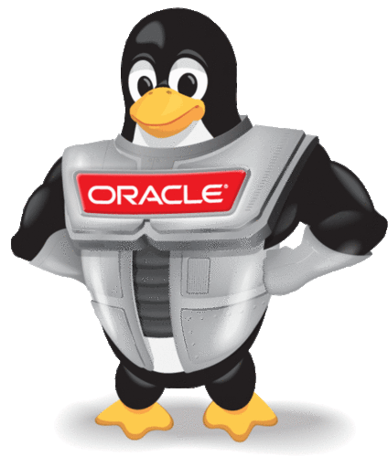
Wercker: Build, Test, Push and Deploy Pipelines for Containers
µ
µ
µ

Slide 59
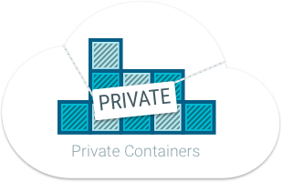
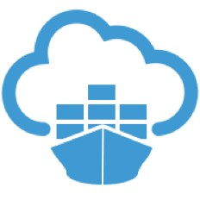

Oracle Container Registry for Your Images
After build and before run – container images need to be stored
Secure (because runtime artefacts)
Accessible (& low latency) to deployment engine and container runtime
Scalable and Smart (no duplicate images and image layers)
Notes:
https://docs.us-phoenix-1.oraclecloud.com/Content/Registry/Concepts/registryoverview.htm?Highlight=registry

Slide 60
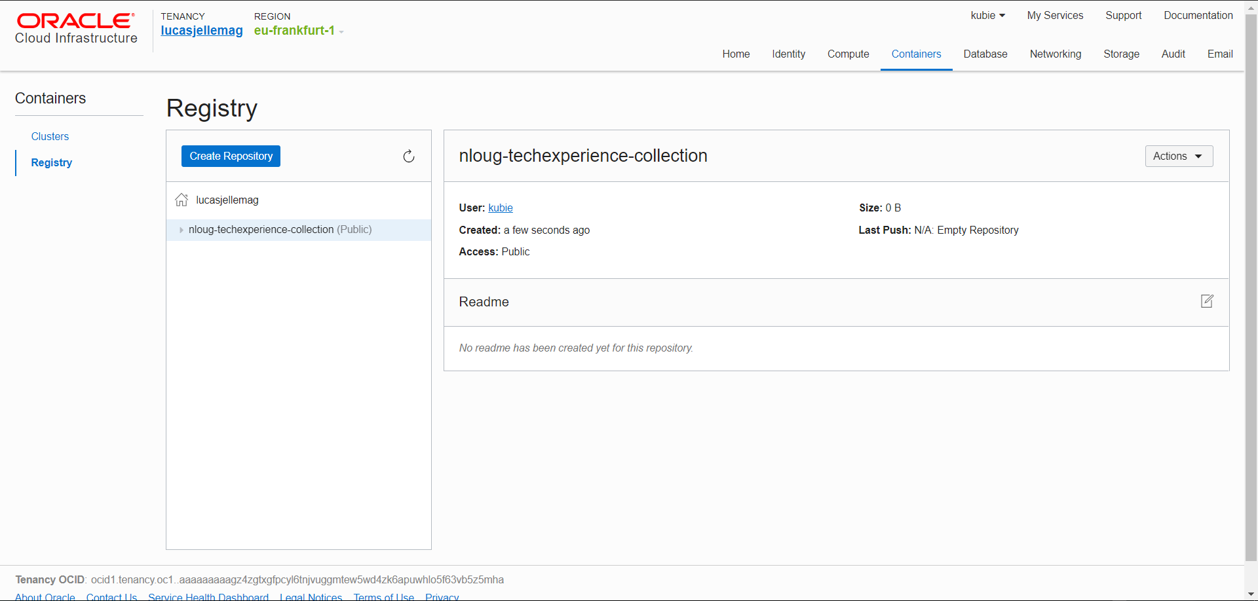

Slide 61
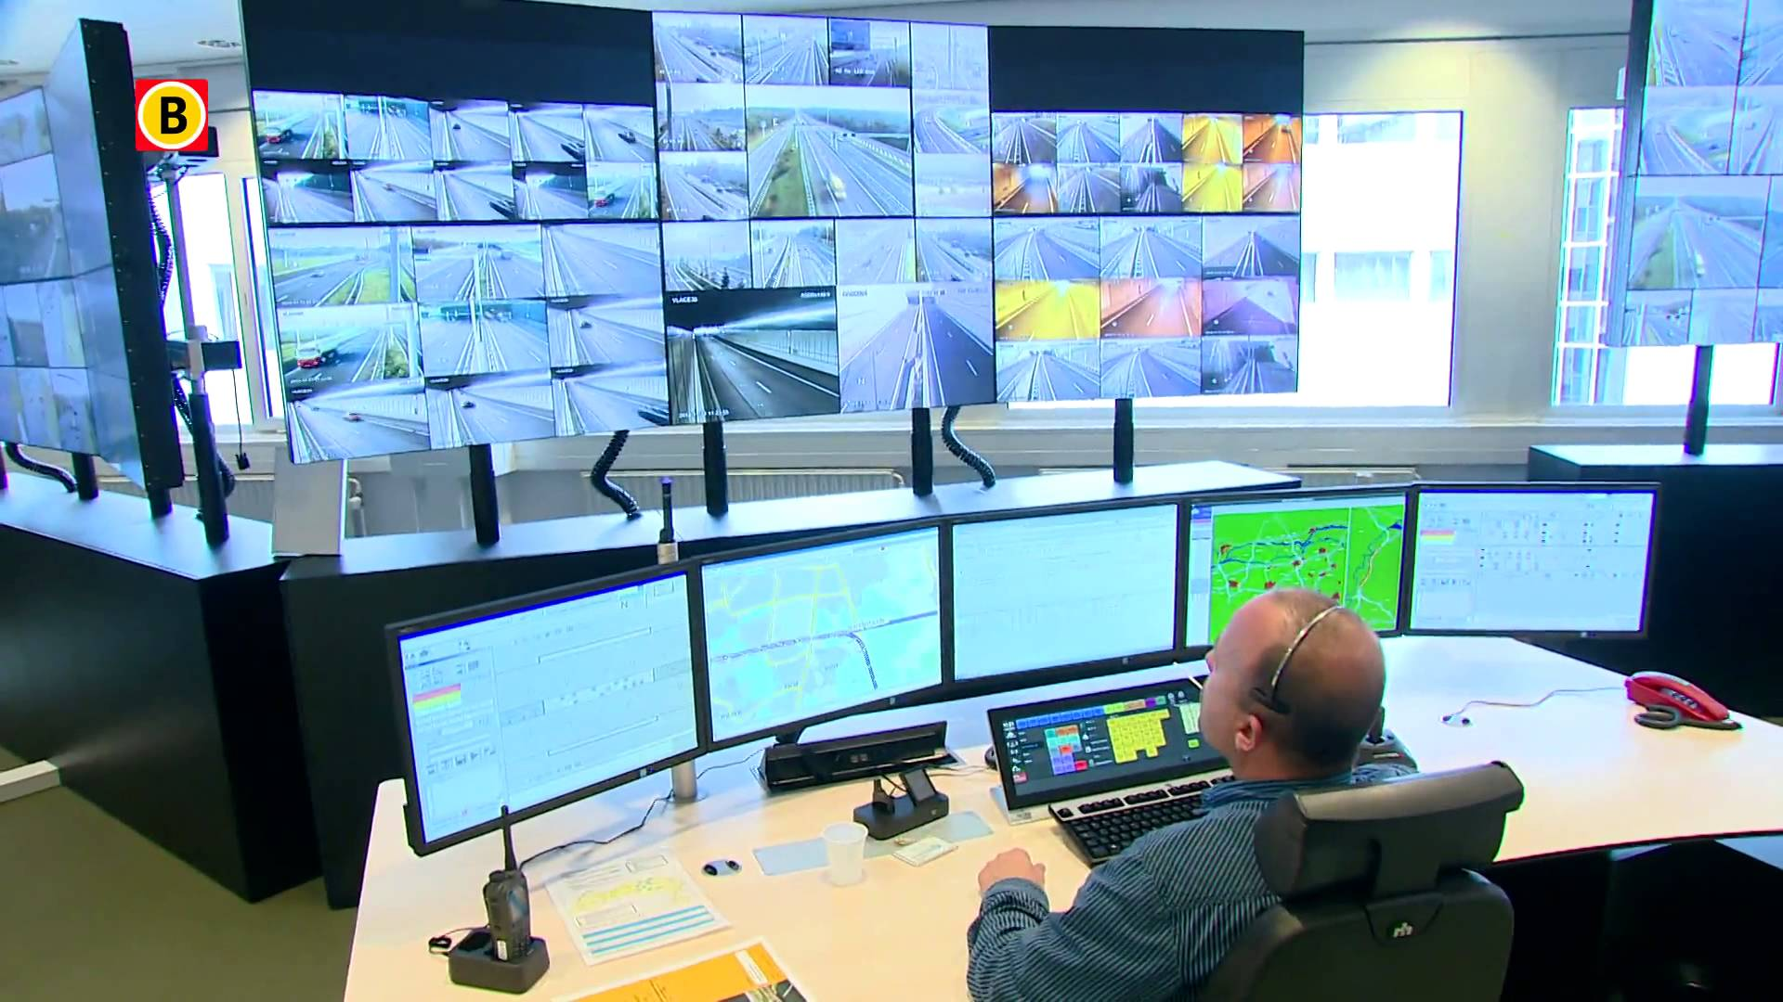


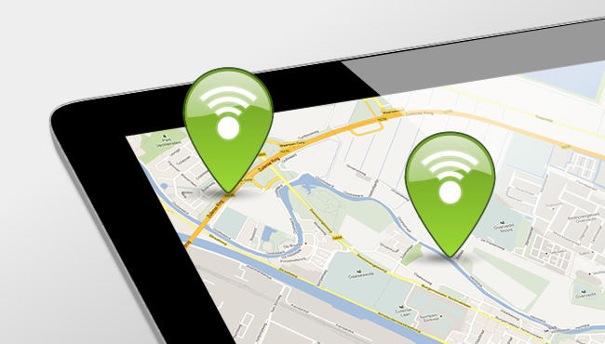
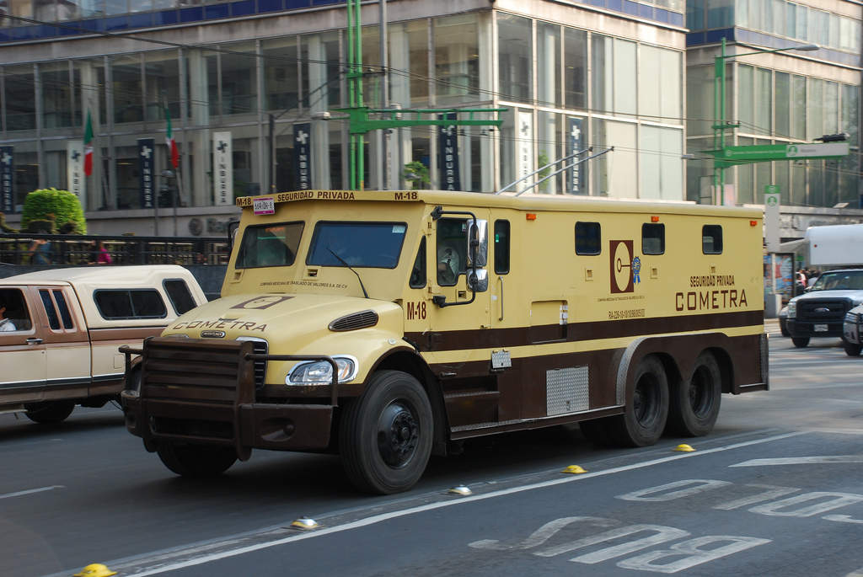



Microservice Runtime Platform - plus
Notes:
Monitor
Health
Load/performance
Tracing
Collect metrics & logs for analysis
Route
A/B, Canary, Authorize/Policy Enforcement, Protocols
Circuit Breaker, Throttle (Rate Limiting)
Mirror traffic for asynchronous testing
Security
TLS
Access control – whitelist/blacklist,

Slide 62


Slide 63





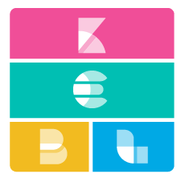


Istio – Service Mesh Operations
Routing
Access Control
Whitelist/Blacklist
Security
TLS
Resilience
Rate Limiting & Circuit Breaker
Monitoring
Trace
Service Graph

Slide 64
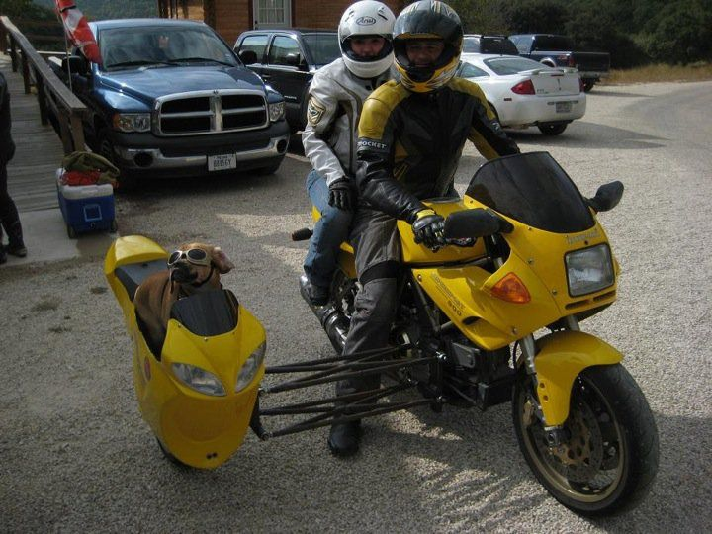
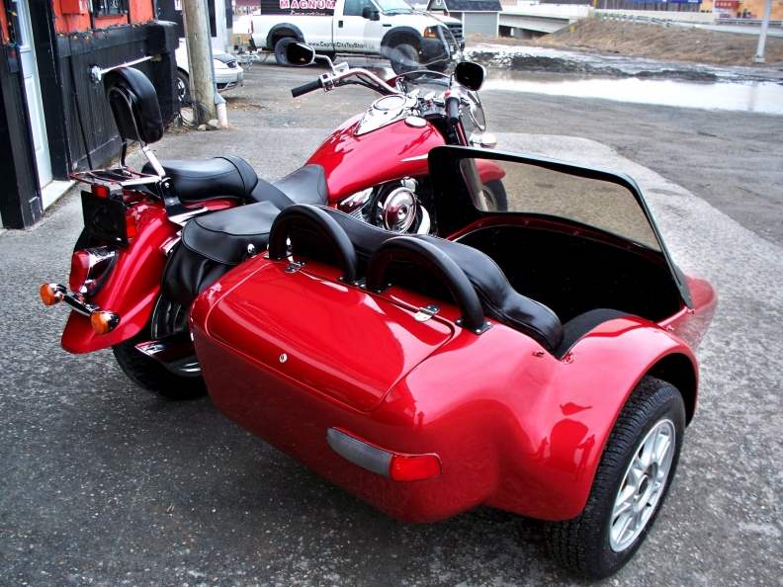

Slide 65
Envoy Sidecar
http(s), tcp,gRPC
Pod
Envoy Sidecar
Metrics, trace, policy checks
Istio Mixer
Configuration
Istio Pilot
TLS Certificates
Istio Auth
Notes:
Docker container
Injected into Pod
Handles all inbound/outbound traffic
Guided by Pilot
Reporting to Mixer

Slide 66
Istio Demo

Slide 67
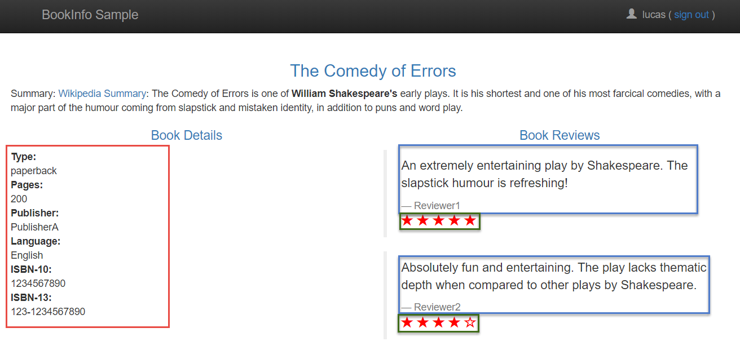
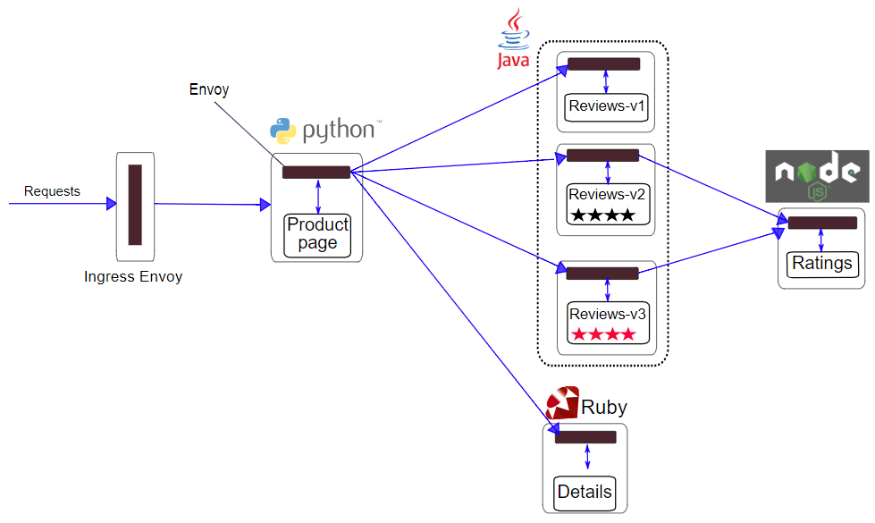

Slide 68

Istio – Bookinfo Demo
10% weight for routing to Reviews-v2
Content based routing to Reviews-v3 for special user
Denier/Blacklist on Details
90%
User = lucas
Notes:
Pod A does sequential calls to B and C
Pod D takes fairly long
Alternative: show bookinfo!

Slide 69
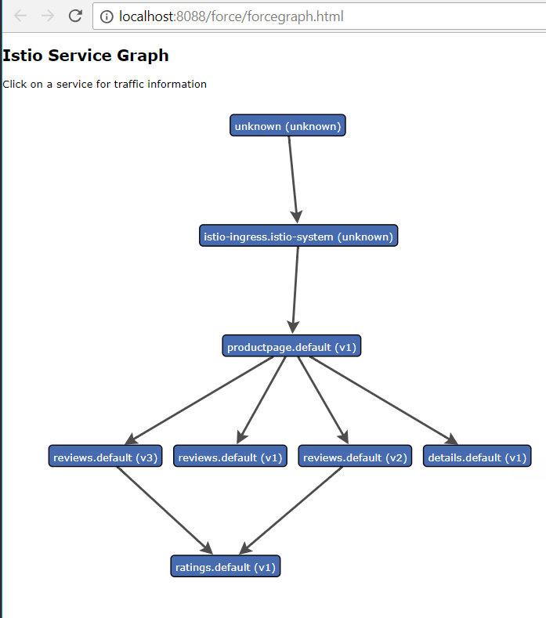
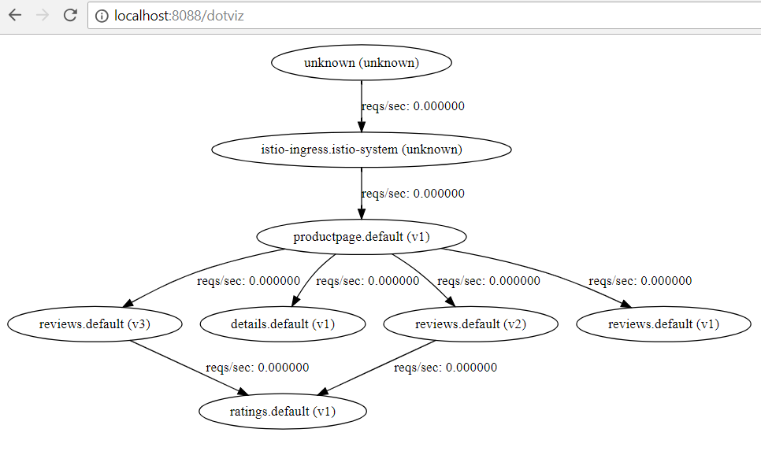

Slide 70
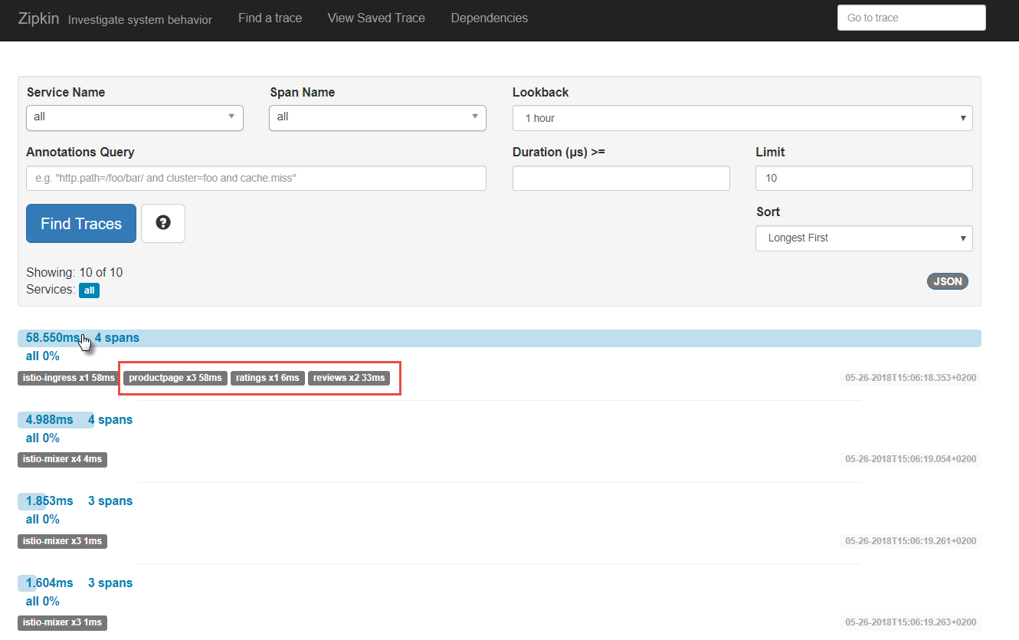
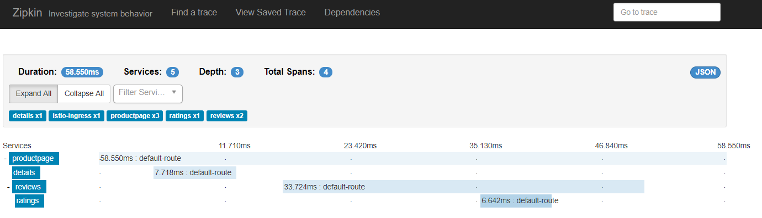

Slide 71
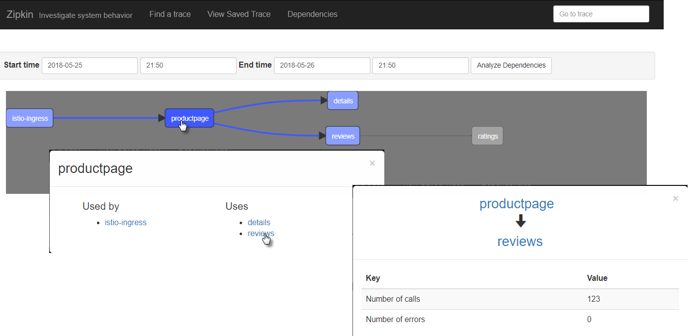
Zipkin Tracing

Slide 72
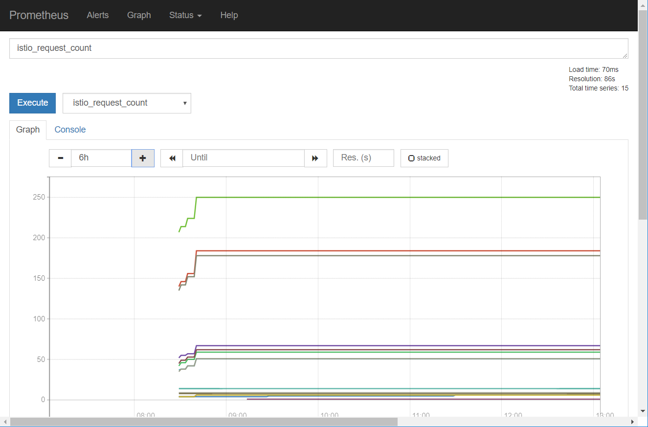
Prometheus

Slide 73
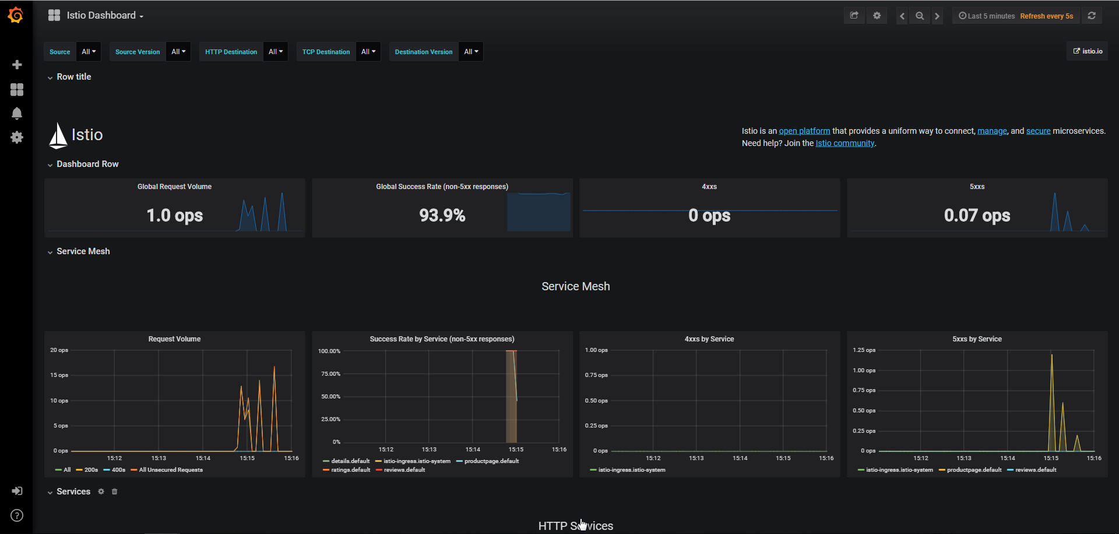
Grafana

Slide 74
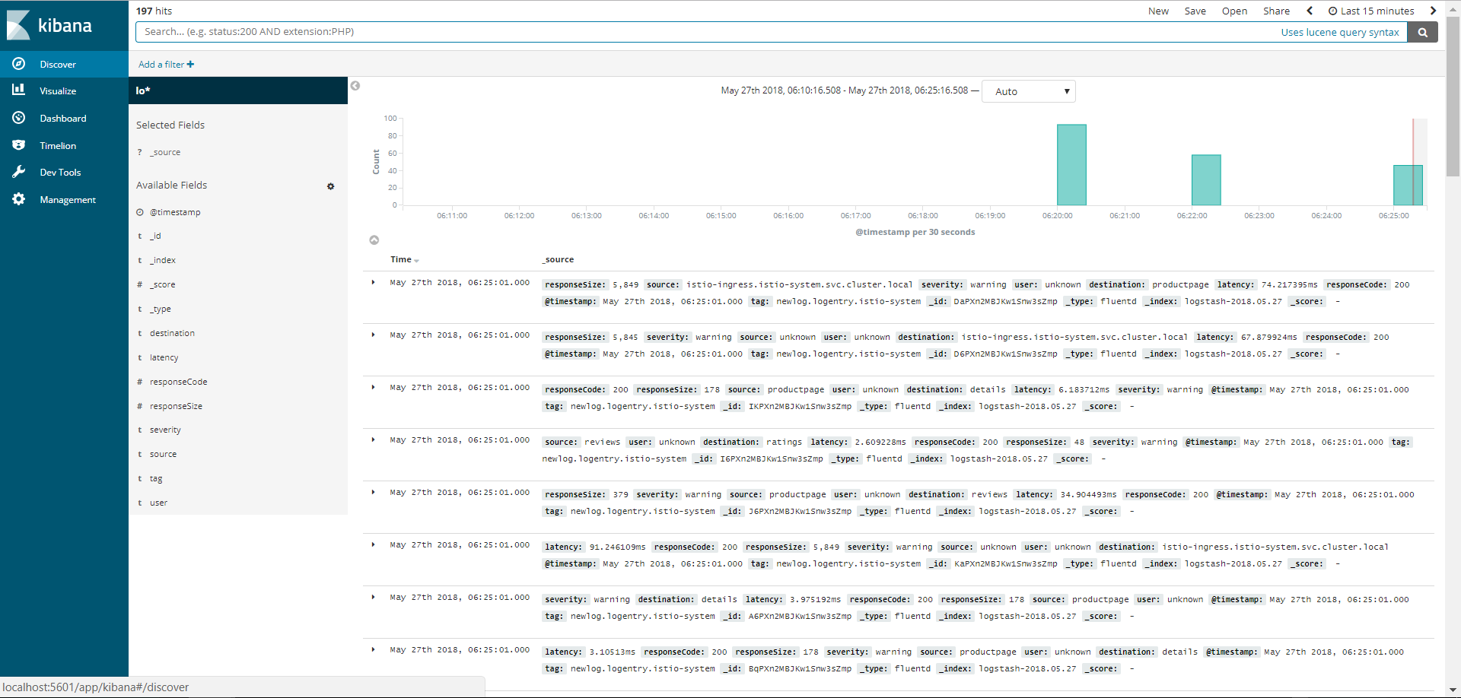
Fluentd + Elastic Stack

Slide 75
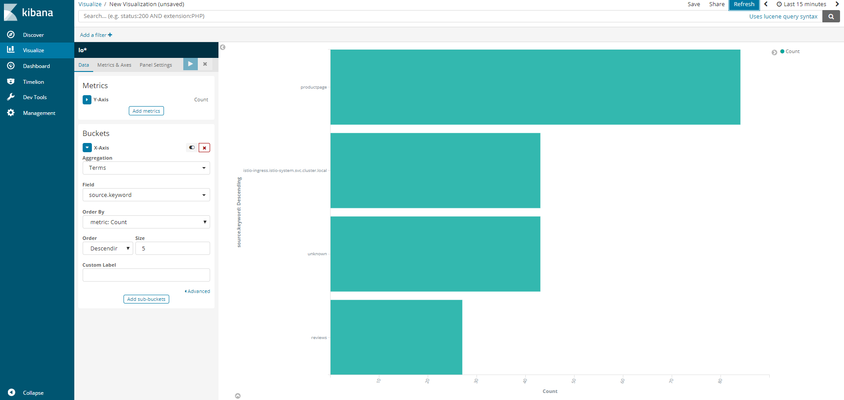
Fluentd + Elastic Stack

Slide 76
Istio – Demo
Each service returns its name and version – and perhaps some payload
And writes some logging
Demo
Call Pod A – only v1 responses
Check Zipkin
Check Grafana
Generate Service Graph
Switch 50% of traffic from Pod A v1 to v2
Header based routing to v3
Check responses
Check Service Graph
Check Kibana
Pod D
v1
Pod A
v3
Pod B
Pod A
v2
http
v2
Pod B
Pod A
v1
v1
Pod C
v2
Pod C
v1
Notes:
Pod A does sequential calls to B and C
Pod D takes fairly long
Alternative: show bookinfo!

Slide 77
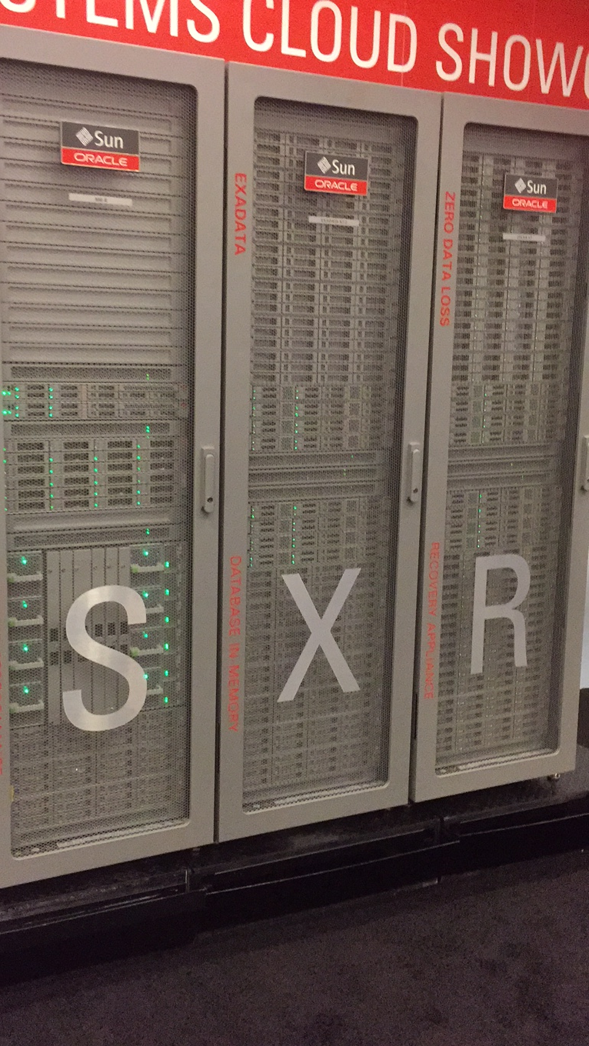
Serverless
λ
λ
λ
λ
λ
λ
λ
λ
λ
λ
λ
µ

Slide 78

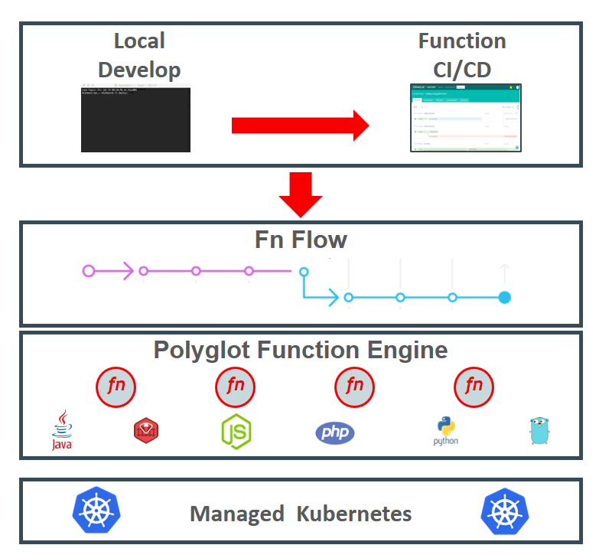
Open Source Serverless Function Platform
Functions can be implemented in any language
Java, Go, PHP, JavaScript/Node, Python, Ruby
Functions run in their own container
Functions can be accessed via HTTP calls
Routing, load balancing, running is taken care of by Fn Server platform
Platform runs locally, on prem & in cloud
Fn Flow orchestrates workflows across multiple functions
Workflow described in Java
Includes business logic (conditional, parallel execution, exceptions)
µ
Notes:
https://blogs.oracle.com/developers/kubecon-europe-2018-oracle-open-serverless-standards-fn-project-and-kubernetes

Slide 79

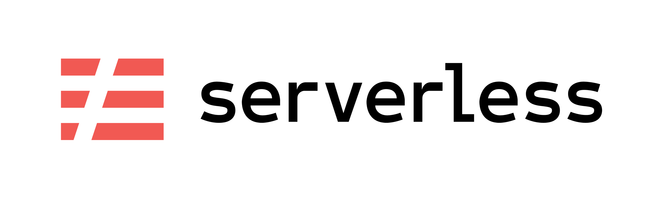
Project Fn has announced support for
Notes:
https://cloudevents.io/
https://serverless.com/

Slide 80
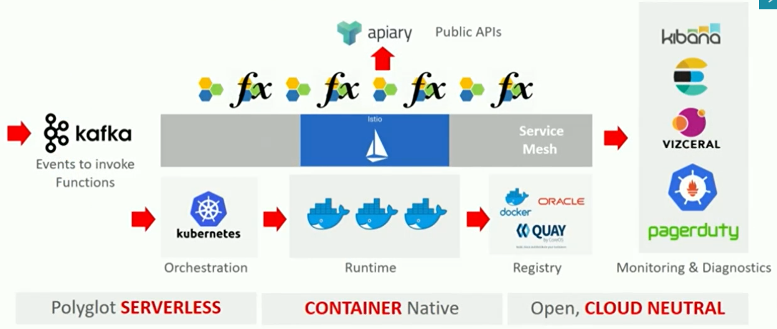
Managed Serverless Platform on Oracle Public Cloud
λ
µ

Slide 81
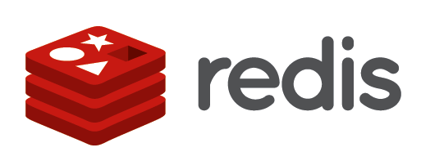











Microservices Platform (Kubernetes & Istio) ++
API Gateway
Cache
Event Hub
Service Broker
Chaos Monkey & Regression Testing
Workflow
Transactions (cross microservice)
RDBMS, NoSQL, Data Lake(Big Data), Fast Data Ingestion
Billing
Notification
Microservices Platform
Storage

Slide 82



Oracle Container Native Microservices Architecture
µ
λ
Foo2
Voice Recognition
API Registry
Event Management
Open Service Broker
Billing Engine
ISTIO
Diagnostics/Monitoring
Prometheus
Developer Cloud
ISTIO
ISTIO
Managed Kubernetes
Block Storage
Cache
RDBMS
LDAP/IdM
NoSQL

Slide 83





Thank you Dank je wel
Blog: technology.amis.nl
Email: lucas.jellema@amis.nl
: @lucasjellema
: lucas-jellema
: www.amis.nl, info@amis.nl

Slide 84
Technologies
Docker containers
CD Pipelines (Wercker, Developer CS, Jenkins X)
Kubernetes as deployment platform
Distributed
Rolling Upgrades
Load Balancing & Networking
Failover
Elastic scaling
Helm for predefined rollout
Istio plus side cars
Service Mesh
Routing – policies, authorize, A/B, canary, throttle
Metrics
Circuitbreaker
Prometheus – collect metrics

Slide 85
Technologies (2)
Grafana – Visualize metrics
Vizceral – visualize traffic
Kafka – events
Elastic – logs??
Redis – cache??
API Gateway??
Camunda/Conductor – workflow
Fn - Serverless

